Slide 1
Analytical Methods for Business
Dr. Ronald K. Satterfield
Muma College of Business
University of South Florida

Slide 2
Simple Linear Regression Everything I Need to Know I Learned in the 7th Grade
Dr. Ronald K. Satterfield
Muma College of Business
University of South Florida

Slide 3
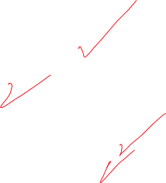
Plan for This Presentation
Building on Video Lecture
Demonstrating Tools in R
Introduction | Examples | Assumptions
Confidence Intrvls. | Being Careful | Pitfalls | Summary

Slide 4
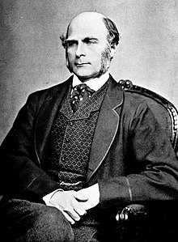
The Originator of Regression
Francis Galton
Introduction | Examples | Assumptions
Confidence Intrvls. | Being Careful | Pitfalls | Summary

Slide 5
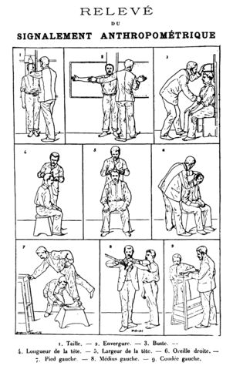
Replaced the Bertillion System
Introduction | Examples | Assumptions
Confidence Intrvls. | Being Careful | Pitfalls | Summary

Slide 6
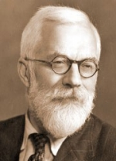
Extensions for Regression
R.A. Fisher
Introduction | Examples | Assumptions
Confidence Intrvls. | Being Careful | Pitfalls | Summary

Slide 7
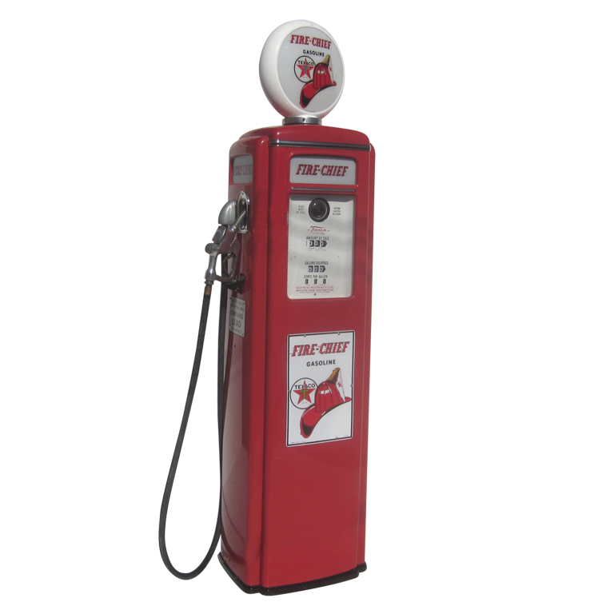
Conducting a Regression Analysis
Data Set: Oil and Gas 1
Introduction | Examples | Assumptions
Confidence Intrvls. | Being Careful | Pitfalls | Summary
Notes:
7

Slide 8
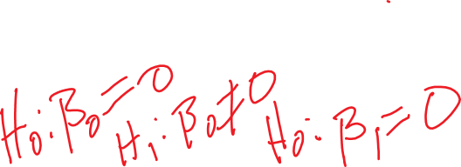
Simple Regression Models
Introduction | Examples | Assumptions
Confidence Intrvls. | Being Careful | Pitfalls | Summary
Notes:
8

Slide 9
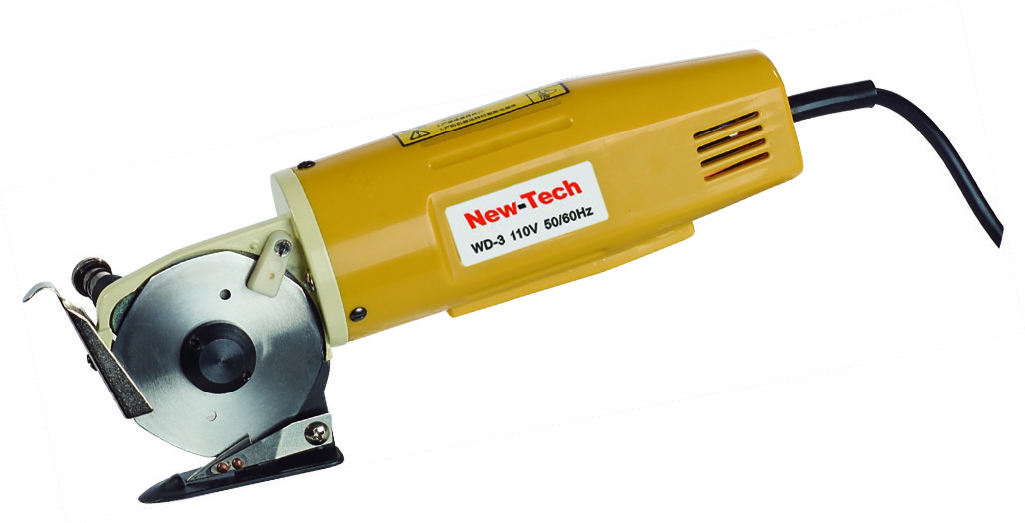
Conducting a Regression Analysis
Data Set: Cutting Tools
Introduction | Examples | Assumptions
Confidence Intrvls. | Being Careful | Pitfalls | Summary
Notes:
9

Slide 10
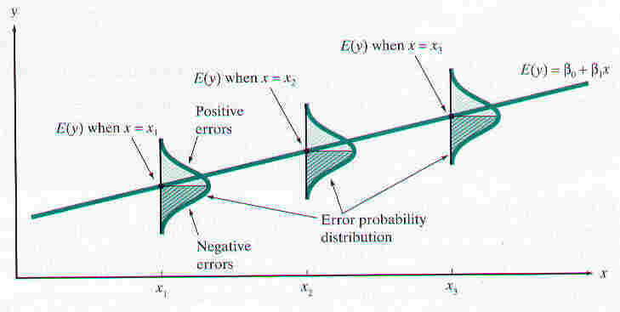
Regression Assumptions (L.I.N.E.)
Be very familiar with the model assumptions.
Introduction | Examples | Assumptions
Confidence Intrvls. | Being Careful | Pitfalls | Summary
Notes:
10

Slide 11
Regression Assumptions (L.I.N.E.)
Linearity
Independence
Normality
Equality of Variances
Introduction | Examples | Assumptions
Confidence Intrvls. | Being Careful | Pitfalls | Summary
Notes:
11

Slide 12
Regression Assumptions (L.I.N.E.)
Linearity
Independence
Normality
Equality of Variances
Introduction | Examples | Assumptions
Confidence Intrvls. | Being Careful | Pitfalls | Summary
Notes:
12

Slide 13
Regression Assumptions (L.I.N.E.)
Linearity
Independence
Normality
Equality of Variances
Introduction | Examples | Assumptions
Confidence Intrvls. | Being Careful | Pitfalls | Summary
Notes:
13

Slide 14
Regression Assumptions (L.I.N.E.)
Linearity
Independence
Normality
Equality of Variances
Introduction | Examples | Assumptions
Confidence Intrvls. | Being Careful | Pitfalls | Summary
Notes:
14

Slide 15
Regression Assumptions (L.I.N.E.)
Linearity
Independence
Normality
Equality of Variances
Introduction | Examples | Assumptions
Confidence Intrvls. | Being Careful | Pitfalls | Summary
Notes:
15

Slide 16

Regression Assumptions (L.I.N.E.)
Linearity
Independence
Normality
Equality of Variances
Heteroscedasticity
Homoscedasticity
Introduction | Examples | Assumptions
Confidence Intrvls. | Being Careful | Pitfalls | Summary
Notes:
16

Slide 17
Two Kinds of Confidence Intervals on y
Confidence Interval Estimate for the Mean of y
Prediction Interval for an Individual Response
Introduction | Examples | Assumptions
Confidence Intrvls. | Being Careful | Pitfalls | Summary
Introduction | Examples | Assumptions
Confidence Intrvls. | Being Careful | Pitfalls | Summary
Notes:
17

Slide 18

Being Careful with Regression
Data Set: Child Abuse
Introduction | Examples | Assumptions
Confidence Intrvls. | Being Careful | Pitfalls | Summary
Notes:
18

Slide 19
Being Careful
Check Assumptions (Degrees of Violation)
Check Residuals
Check Confidence & Prediction Intervals
Introduction | Examples | Assumptions
Confidence Intrvls. | Being Careful | Pitfalls | Summary
Notes:
19

Slide 20
Potential Pitfalls
Assumptions of Regression (Not Aware, Not Checking for Violations)
Not Knowing How to Assess the Impact of Assumption Violations
Using Regression Without Understanding Subject Matter
Extrapolating Outside the Relevant Range
Assuming Cause-and-Effect Between x and y
Introduction | Examples | Assumptions
Confidence Intrvls. | Being Careful | Pitfalls | Summary
Notes:
20

Slide 21
What Have We Covered?
Practice with Simple Linear Regression
Examples in R
Interpretation (Correlations, Coefficients, Residual Analyses)
Assumptions of Regression (L.I.N.E.)
Introduction | Examples | Assumptions
Confidence Intrvls. | Being Careful | Pitfalls | Summary

